Slide 1
How might we help Canadians impactfully reduce waste？

Slide 2

The Problem

Slide 3


Slide 4
Our Solution
Provide
Information of Food Packaging
List of Items
Motivate
Reward System
Save Money
Reduce
Food Waste
Packaging Waste

Slide 5
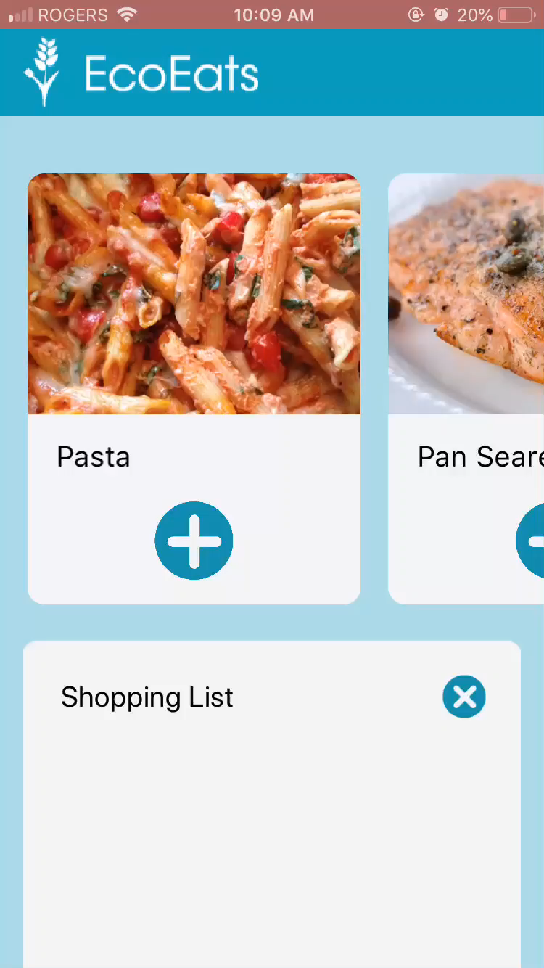
Meal Selection
List Ingredients
Create List

Slide 6
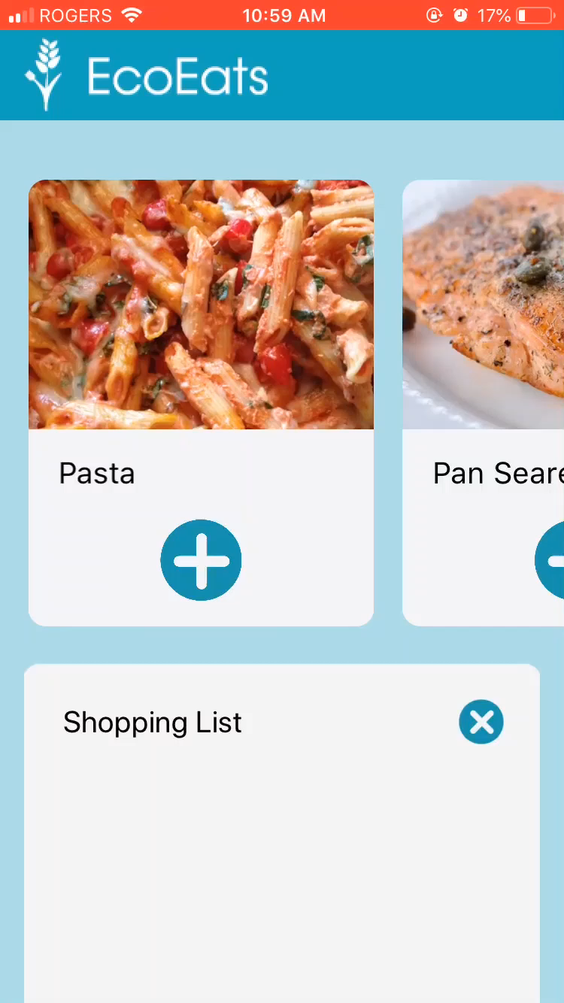
Scan Barcode
Track Effect
Evaluate

Slide 7
Promotion
Advertisements
Social Media

Slide 8






Financial Plan
Advertisements
Partnerships with Grocers
Endorsements of Eco-Friendly Businesses
Premium Subscription
Low Operation Costs
Sense of Social Responsibility

Slide 9
Operations
Analysis of User Reviews
Updates and Bug Fixes
Extension to Android

Slide 10
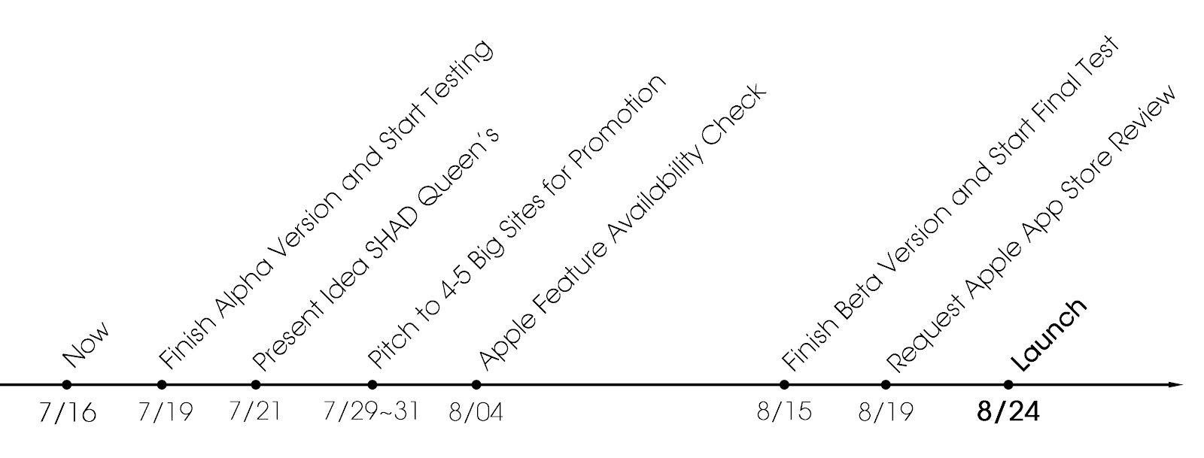
Future Planning

Slide 11


Competitors

Slide 12
Human Resources
Amey Dhamgunde: Programming
Signe Anderson: Executive Officer
Nilu Jahandardoost: Customer Services, Financials
Suryakant Jain and Leo Chai: Graphic Design and Research
Kelly Wong: Statistics, Media Relations

Slide 13
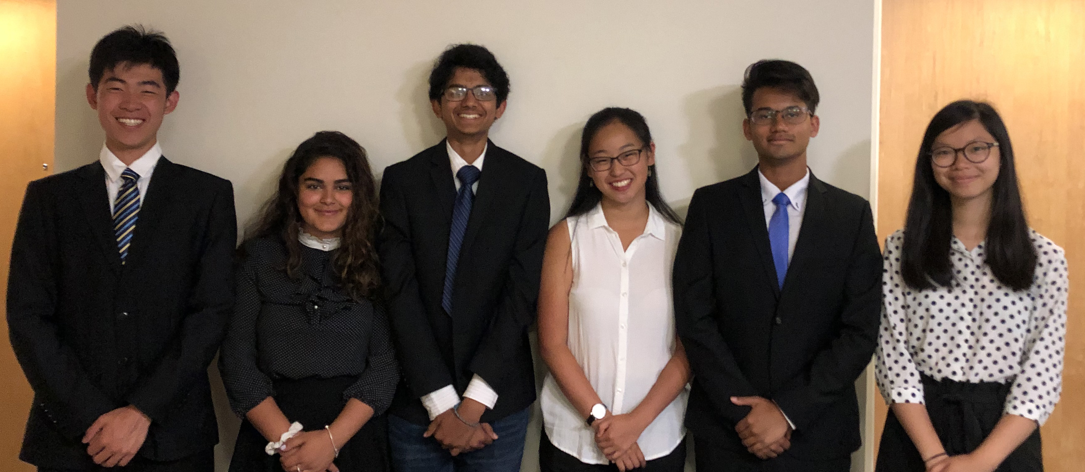
Our Team
Amey
Dhamgunde
Signe
Anderson
Leo
Chai
Kelly
Wong
Nilu
Jahan
Suryakant
Jain

